Slide 1
Introduction to Arduino Programming
Course Instructor: Tejas S Shah

Slide 2

Contents
Exploring various Development Boards
Introduction to Sensors and Interfacing
Project Design Cycle
Lab 2: Ex1, Ex2
Assignment-1 (PWM) - Homework

Slide 3
Exploring various Development Boards
Arduino Nano 33 BLE
Teensy 4.0
SparkFun Edge Development Board
NodeMCU
Wemos D1 Mini Pro

Slide 4
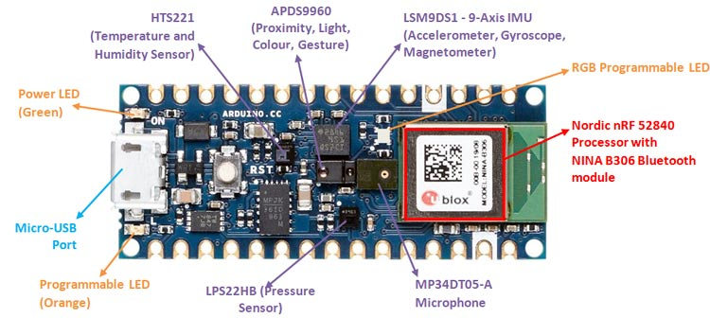
Arduino Nano 33 BLE
Chip: NINA-B3 – RF52840
Clock: 64MHz
Flash : 1MB
SRAM: 256 KB
Wireless Connectivity: Bluetooth 5.0 / BLE
Interfaces: USB, I2C, SPI, I2S, UART

Slide 5
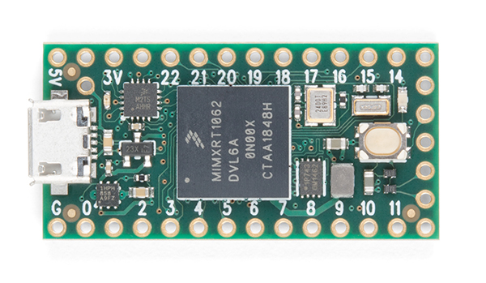
Teensy 4.0
ARM Cortex-M7 at 600MHz
1024K RAM (512K is tightly coupled)
2048K Flash (64K reserved for recovery & EEPROM emulation)
2 USB ports, both 480MBit/sec
3 CAN Bus, 2 I²S Digital Audio, 1 S/PDIF Digital Audio, 1 SDIO (4 bit) native SD, 3 SPI, 3 I²C
31 PWM pins
40 digital pins, all interrrupt capable
14 analog pins, 2 ADCs on chip
Cryptographic Acceleration
RTC for date/time

Slide 6
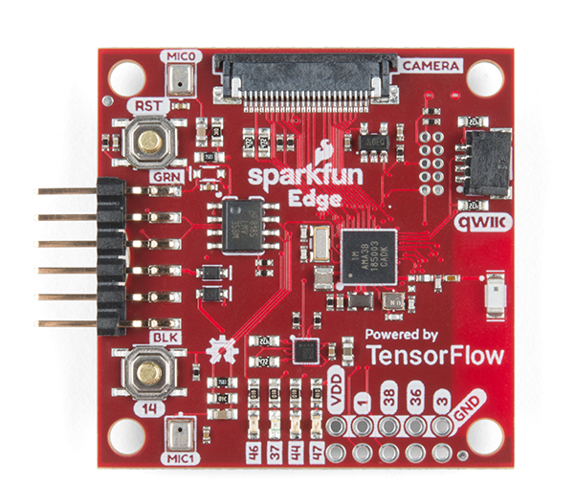
SparkFun Edge Development Board
32-bit ARM Cortex-M4F processor with Direct Memory Access
48MHz CPU clock, 96MHz with TurboSPOT™
Extremely low-power usage: 6uA/MHz
1MB Flash
384KB SRAM
Dedicated Bluetooth processor with BLE 5
ST LIS2DH12 3-axis accelerometer
2x MEMS microphones with operational amplifier
Himax HM01B0 camera connector

Slide 7
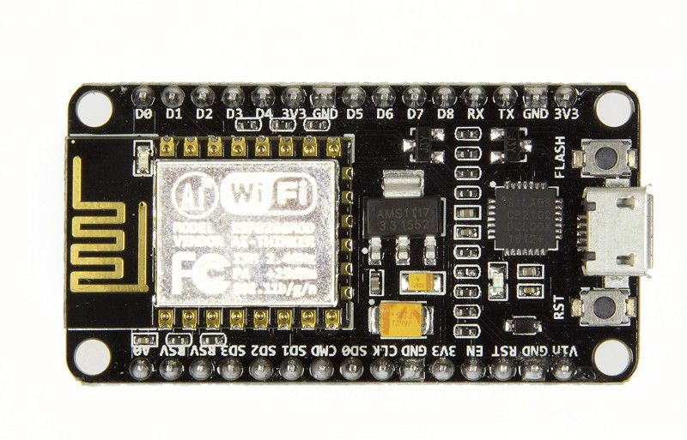
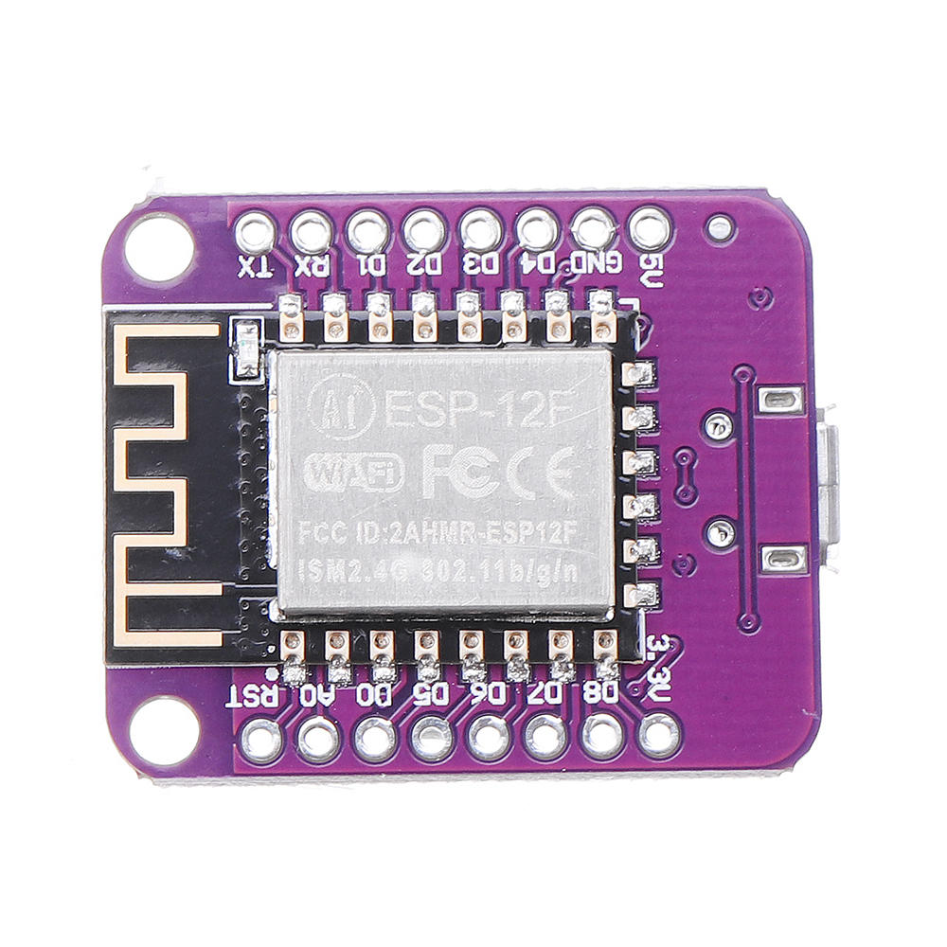
WiFi enabled Boards
NodeMCU
Wemos D1 Mini Pro

Slide 8
Sensor Interfacing Basics
Arduino + Temperature Sensor
Arduino + Bluetooth Module

Slide 9
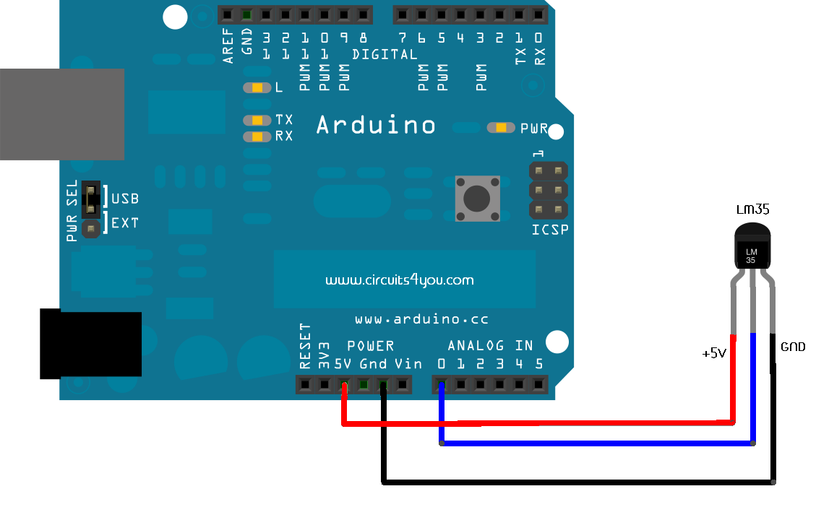
Arduino + Temperature Sensor
LM35 is a precision temperature sensor with its output proportional to the temperature (in ºC)
The operating temperature range is from -55°C to 150°C.
Sensor gives linear + 10.0 mV/°C scale factor, as per that we have set the calibration in program Vref=5V
ADC Count for 1°C = 10m/(5/1024) = 2.048 Temperature=ADC Count/2.048

Slide 10
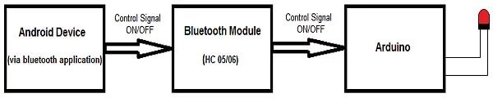
Arduino + Bluetooth Module
Ever thought of controlling any of your electronic devices with your smartphone? Now, you can!
There are three main parts to this project. An Android smartphone, a Bluetooth transceiver, and an Arduino.
HC 05/06 works on serial communication.
If the received data is 1, the LED turns ON. The LED turns OFF when the received data is 0. You can open the serial monitor and watch the received data while connecting.

Slide 11
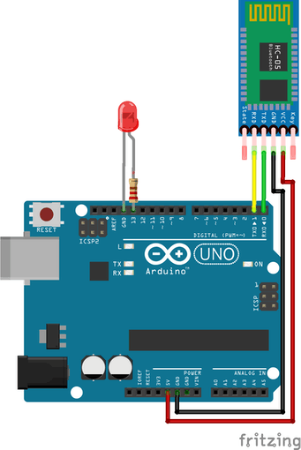
Connection Diagram
The circuit is so simple and small, there are only a few connections to be made
Arduino Pins Bluetooth Pins
RX (Pin 0) ———-> TX
TX (Pin 1) ———-> RX
5V ———-> VCC
GND ———-> GND

Slide 12
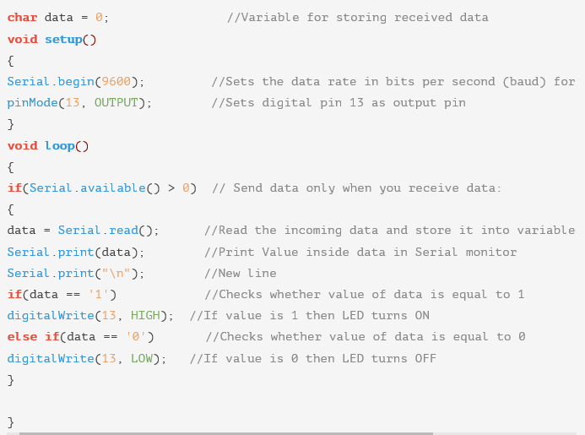
Upload Code

Slide 13
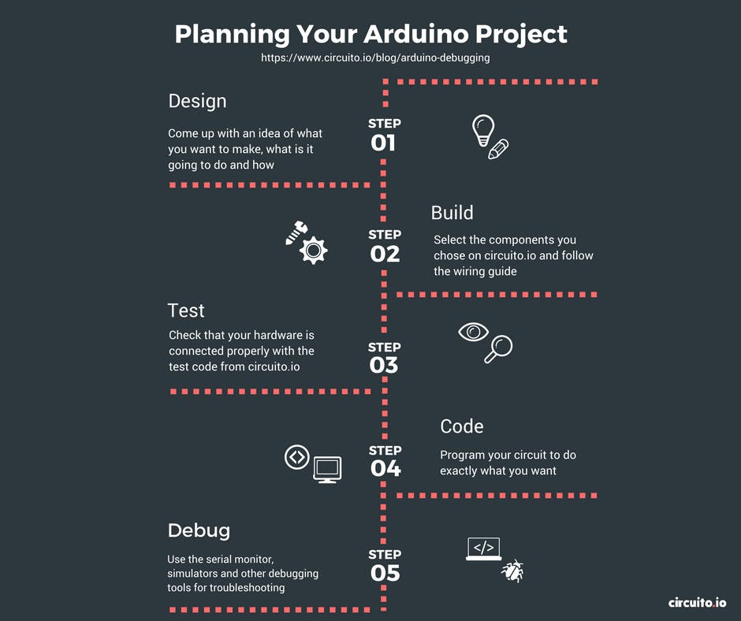

Slide 14
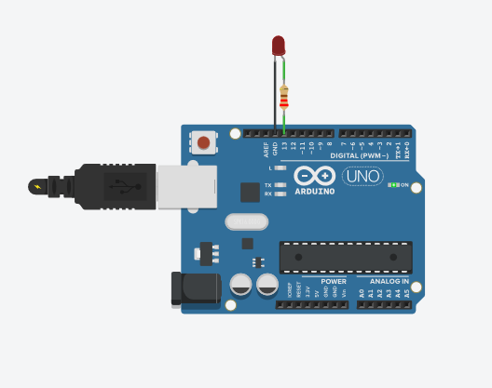
Ex.1 – PWM using TinkerCAD
int brightness = 0;
void setup()
{
pinMode(9, OUTPUT);
}
void loop()
{
for (brightness = 0; brightness <= 255; brightness += 5) {
analogWrite(9, brightness);
delay(30); // Wait for 30 millisecond(s)
}
for (brightness = 255; brightness >= 0; brightness -= 5) {
analogWrite(9, brightness);
delay(30); // Wait for 30 millisecond(s)
}
}
Notes:
https://www.tinkercad.com/things/7Da6UPBUyKG-fading-led-with-analog-output/editel?lessonid=EDUBKUOJAIJNNJX&projectid=OMOZACHJ9IR8LRE&collectionid=OMOZACHJ9IR8LRE&tenant=circuits#/lesson-viewer

Slide 15
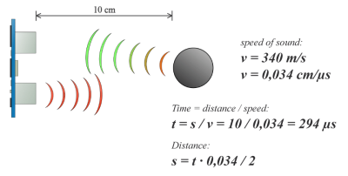
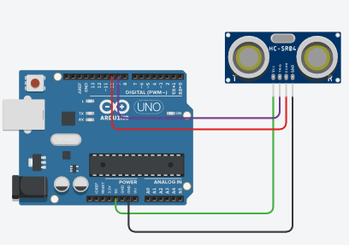
Ex.2 – Distance Measurement using TinkerCAD
Notes:
https://howtomechatronics.com/tutorials/arduino/ultrasonic-sensor-hc-sr04/

Slide 16
// defines pins numbers
const int trigPin = 9;
const int echoPin = 10;
// defines variables
long duration;
int distance;
void setup() {
pinMode(trigPin, OUTPUT); // Sets the trigPin as an Output
pinMode(echoPin, INPUT); // Sets the echoPin as an Input
Serial.begin(9600); // Starts the serial communication
}
void loop() {
// Clears the trigPin
digitalWrite(trigPin, LOW);
delayMicroseconds(2);
// Sets the trigPin on HIGH state for 10 micro seconds
digitalWrite(trigPin, HIGH);
delayMicroseconds(10);
digitalWrite(trigPin, LOW);
// Reads the echoPin, returns the sound wave travel time in microseconds
duration = pulseIn(echoPin, HIGH);
// Calculating the distance
distance= duration*0.034/2;
// Prints the distance on the Serial Monitor
Serial.print("Distance: ");
Serial.println(distance);
}
Notes:
https://www.tinkercad.com/things/6nAQ7DRYZk7-smashing-wluff/editel?tenant=circuits

Slide 17
Assignment 1 (Homework)
Topic
Pulse Width Modulation (PWM) implementation using LED on TinkerCAD
Workflow
Create a fresh TinkerCAD simulation environment.
Select relevant components.
Write the necessary code.
Compile and Simulate the sketch.

Slide 18
Thank You
End of Day 3. Questions?

